Slide 1
ECG spectrogram scalogram

Slide 2
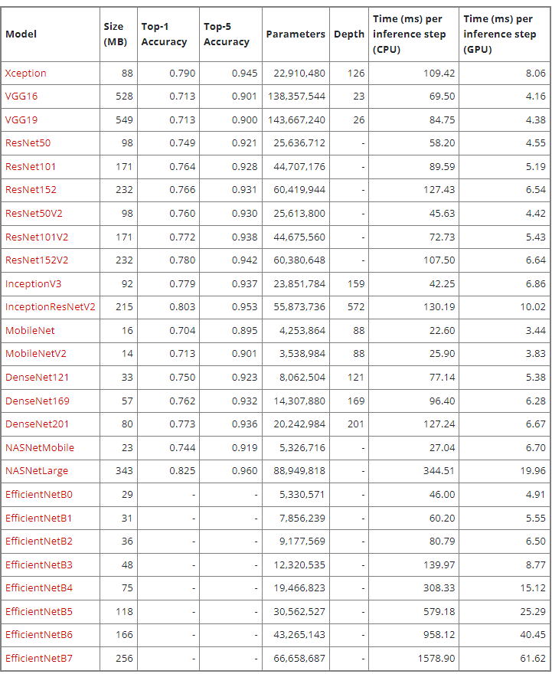
Model Accuracy

Slide 3

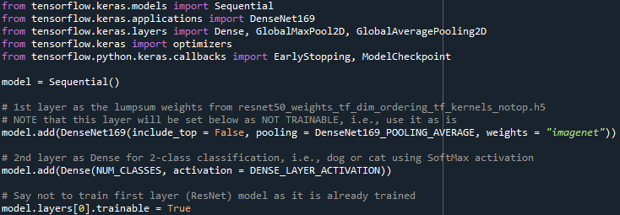
DenseNet169

Slide 4


DenseNet169 vs InceptionV3
Den_lead1
Incept_lead1

Slide 5


Den_lead2
Incept_lead2

Slide 6


Den_lead3
Incept_lead3

Slide 7


Den_lead4
Incept_lead4

Slide 8


Den_lead5
Incept_lead5

Slide 9


Den_lead6
Incept_lead6

Slide 10


Den_lead7
Incept_lead7

Slide 11


Den_lead8
Incept_lead8

Slide 12


Den_lead9
Incept_lead9

Slide 13


Den_lead10
Incept_lead10

Slide 14


Den_lead11
Incept_lead11

Slide 15


Den_lead12
Incept_lead12

Slide 16

DenseNet169 result

Slide 17
감사합니다

